Slide 1
Eclipse Plug-in Development
SWT/JFace Development Part 1
Controls

Slide 2
Contents
Introducing the Widget and Control classes
Labels
Involving the user with buttons
Editing text with SWT
Combo and List
Sash and SashForm
ToolBar and CoolBar
Slider, Scale and Spinner
ProgressBar and ToolTip
Menus
Tray and TaskBar
Working with events

Slide 3
Introducing the Widget and Control classes
Widget
Superclass of all user interface objects
Constructor: parent and style
Issue notification to listeners
Holding Data
Dispose
Control
Superclass of all windowed user interface classes
Size, Location and Region
Color, Font and Image
Visible and Enable

Slide 4
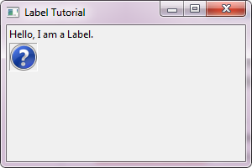
Label
Text or Image
Label textLabel= new Label(shell, SWT.NONE);
textLabel.setText("Hello, I am a Label.");
Label imageLabel = new Label(shell, SWT.BORDER);
imageLabel.setImage(display.getSystemImage(SWT.ICON_QUESTION));

Slide 5
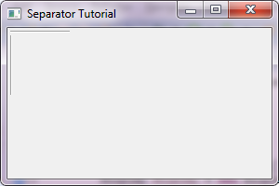
Label
Separator
SWT.SEPARATOR
SWT.HORIZONTAL, SWT.VERTICAL
new Label(shell, SWT.SEPARATOR | SWT.HORIZONTAL);
new Label(shell, SWT.SEPARATOR | SWT.VERTICAL);

Slide 6
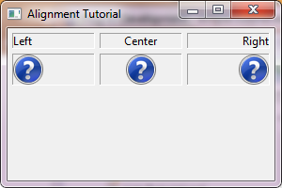
Label
Label Alignment
SWT.LEFT
SWT.RIGHT
SWT.CENTER
Label leftLabel = new Label(shell, SWT.LEFT|SWT.BORDER);
leftLabel.setText("Left");
Label centerLabel = new Label(shell, SWT.CENTER | SWT.BORDER);
centerLabel.setText("Center");
Label rightLabel = new Label(shell, SWT.BORDER);
rightLabel.setText("Right");
rightLabel.setAlignment(SWT.RIGHT);

Slide 7
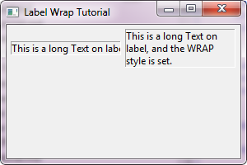
Label
Auto Wrap
SWT.WRAP
Label noWrapLabel = new Label(shell, SWT.BORDER);
noWrapLabel.setText("This is a long Text on label, but no WRAP style set.");
Label wrapLabel = new Label(shell, SWT.WRAP | SWT.BORDER);
wrapLabel.setText("This is a long Text on label, and the WRAP style is set.");

Slide 8
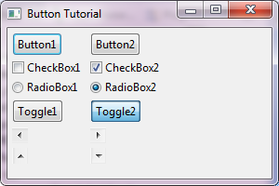
Involving the user with buttons
Normal Button
SWT.NONE
SWT.PUSH
//Button
new Button(shell, SWT.PUSH).setText("Button1");
new Button(shell, SWT.PUSH).setText("Button2");

Slide 9
Involving the user with buttons
Check Box
SWT.CHECK
//CheckBox
new Button(shell, SWT.CHECK).setText("CheckBox1");
Button checkBox = new Button(shell, SWT.CHECK);
checkBox.setText("CheckBox2");
checkBox.setSelection(true);

Slide 10
Involving the user with buttons
Radio Box
SWT.RADIO
//RadioBox
new Button(shell, SWT.RADIO).setText("RadioBox1");
Button radioBox = new Button(shell, SWT.RADIO);
radioBox.setText("RadioBox2");
radioBox.setSelection(true);

Slide 11
Involving the user with buttons
Toggle Buttons
SWT.TOGGLE
//Toggle
new Button(shell, SWT.TOGGLE).setText("Toggle1");
Button toggle = new Button(shell, SWT.TOGGLE);
toggle.setText("Toggle2");
toggle.setSelection(true);

Slide 12
Involving the user with buttons
Arrows
SWT.ARROW
SWT.LEFT, SWT.RIGHT, SWT.TOP and SWT.BOTTOM
//Arrow
new Button(shell, SWT.ARROW|SWT.LEFT);
new Button(shell, SWT.ARROW|SWT.RIGHT);
new Button(shell, SWT.ARROW|SWT.TOP);
new Button(shell, SWT.ARROW|SWT.BOTTOM);

Slide 13
Involving the user with buttons
Selection Listener
SWT.DefaultSelection
SWT.Selection
button.addSelectionListener(new SelectionListener() {
public void widgetSelected(SelectionEvent e) {
// Handle selection event.
}
public void widgetDefaultSelected(SelectionEvent e) {
// is not called
}
});

Slide 14
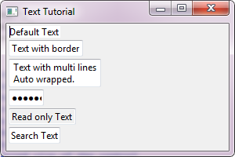
Editing text with SWT
Text
SWT.SINGLE
SWT.MULTI
SWT.WRAP
SWT.PASSWORD
SWT.SEARCH
Text text1 = new Text(shell, SWT.NONE);
text1.setText("Default Text");
Text text2 = new Text(shell, SWT.BORDER);
text2.setText("Text with border");
Text text3 = new Text(shell, SWT.MULTI |SWT.BORDER);
text3.setText("Text with multi lines\nAuto wrapped.");
Text text4 = new Text(shell, SWT.PASSWORD |SWT.BORDER);
text4.setText("123456");
Text text5 = new Text(shell, SWT.READ_ONLY | SWT.BORDER);
text5.setText("Read only Text");
Text text6 = new Text(shell, SWT.SEARCH | SWT.BORDER);
text6.setText("Search Text");

Slide 15
Editing text with SWT
Text Default Selection Listener
SWT.DefaultSelection
text1.addSelectionListener(new SelectionListener() {
public void widgetSelected(SelectionEvent e) {
// Never called for text.
}
public void widgetDefaultSelected(SelectionEvent e) {
// Called when “Enter” pressed
}
});

Slide 16
Editing text with SWT
Text Modify Listener
SWT.Modify
text.addModifyListener(new ModifyListener() {
public void modifyText(ModifyEvent e) {
// Called when text changed
}
});

Slide 17
Editing text with SWT
Text Verify Listener
SWT.Verify
text.addVerifyListener(new VerifyListener() {
public void verifyText(VerifyEvent e) {
int start = e.start; // Change start index
int end = e.end; // Change end index
String newValue = e.text; // Changed value
if ("d".endsWith(newValue)){
e.doit = false; // Refused changes
}
}
});

Slide 18
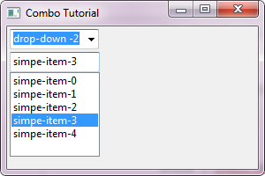
Combo and List
Combo
SWT.SIMPLE
SWT.DROP_DOWN (default)
SWT.READ_ONLY
Combo dropDown = new Combo(shell, SWT.DROP_DOWN);
for (int i = 0; i < 5; i++) {
dropDown.add("drop-down -" + i);
}
dropDown.select(2);
Combo simple = new Combo(shell, SWT.SIMPLE);
for (int i = 0; i < 5; i++) {
simple.add("simpe-item-" + i);
}
simple.select(3);

Slide 19
Combo and List
Combo Text Listeners
SWT.DefaultSelection
SWT.Verify
SWT.Modify
Combo Selection Listener
SWT.Selection
Combo dropDown = new Combo(shell, SWT.DROP_DOWN);
for (int i = 0; i < 5; i++) {
dropDown.add("drop-down -" + i);
}
dropDown.select(2);
dropDown.addSelectionListener(new SelectionAdapter() {
public void widgetSelected(SelectionEvent e) {
//String item = dropDown.getItem(dropDown.getSelectionIndex());
}
});

Slide 20
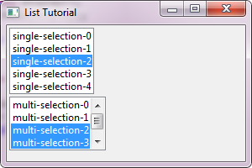
Combo and List
List
SWT.SINGLE
SWT.MULTI
SWT.READ_ONLY
List list1 = new List(shell, SWT.SINGLE | SWT.BORDER);
for (int i = 0; i < 5; i++) {
list1.add("single-selection-" + i);
}
list1.select(2); // Selection
List list2 = new List(shell, SWT.MULTI | SWT.BORDER | SWT.V_SCROLL);
list2.setLayoutData(new RowData(SWT.DEFAULT, 60));
for (int i = 0; i < 5; i++) {
list2.add("multi-selection-" + i);
}
list2.select(2, 3); // Selection

Slide 21
Combo and List
List Selection Listeners
SWT.DefaultSelection
SWT.Selection
list.addSelectionListener(new SelectionListener() {
public void widgetSelected(SelectionEvent e) {
// Selection changed
}
public void widgetDefaultSelected(SelectionEvent e) {
// Double clicked
}
});

Slide 22
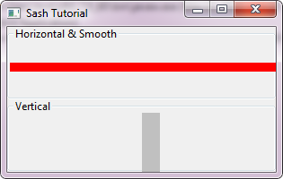
Sash and SashForm
Sash
SWT.VERTICAL
SWT.HORIZONTAL
SWT.SMOOTH
final Sash hSash = new Sash(group1, SWT.HORIZONTAL | SWT.SMOOTH);
Rectangle rect = group1.getClientArea();
hSash.setBounds(rect.x, 40, 315, 10);
hSash.setBackground(display.getSystemColor(SWT.COLOR_RED));
final Sash vSash = new Sash(group2, SWT.VERTICAL);
Rectangle r = group2.getClientArea();
vSash.setBounds(150, r.y, 20, 100);
vSash.addListener(SWT.Selection, new Listener() {
public void handleEvent(Event e) {
vSash.setBounds(e.x, e.y, e.width, e.height);
}
});

Slide 23
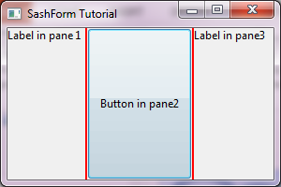
Sash and SashForm
SashFrom
setWeights(int[])
SashForm form = new SashForm(shell, SWT.HORIZONTAL | SWT.SMOOTH);
form.setSashWidth(2);
form.setBackground(display.getSystemColor(SWT.COLOR_RED));
Composite child1 = new Composite(form, SWT.NONE);
child1.setLayout(new FillLayout());
new Label(child1, SWT.NONE).setText("Label in pane 1");
Composite child2 = new Composite(form, SWT.NONE);
child2.setLayout(new FillLayout());
new Button(child2, SWT.PUSH).setText("Button in pane2");
Composite child3 = new Composite(form, SWT.NONE);
child3.setLayout(new FillLayout());
new Label(child3, SWT.PUSH).setText("Label in pane3");
form.setWeights(new int[] { 30, 40, 30 });

Slide 24
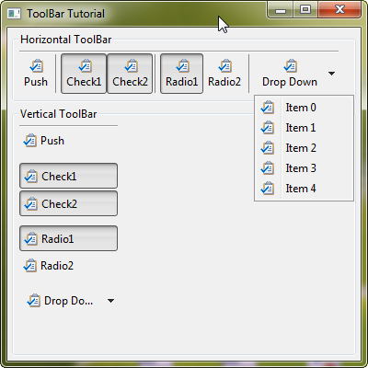
ToolBar and CoolBar
ToolBar and ToolItem
ToolBar
SWT.VERTICAL
SWT.HORIZONTAL
SWT.FLAT
SWT.RIGHT
SWT.WRAP
ToolItem
SWT.PUSH
SWT.CHECK
SWT.RADIO
SWT.CHECK
SWT.DROP_DOWN
SWT.SEPARATOR

Slide 25
ToolBar and CoolBar
ToolBar and ToolItem
// Create a horizontal ToolBar.
final ToolBar hToolBar = new ToolBar(group1, SWT.HORIZONTAL | SWT.FLAT
| SWT.SHADOW_OUT);
new ToolItem(hToolBar, SWT.PUSH).setText("Push");// Push style item.
new ToolItem(hToolBar, SWT.SEPARATOR);// Separator, show only parent style contains 'SWT.FLAT'
new ToolItem(hToolBar, SWT.CHECK).setText("Check1"); // Check style item
new ToolItem(hToolBar, SWT.CHECK).setText("Check2"); // Check style item
new ToolItem(hToolBar, SWT.SEPARATOR);
new ToolItem(hToolBar, SWT.RADIO).setText("Radio1"); // Radio style item
new ToolItem(hToolBar, SWT.RADIO).setText("Radio2"); // Radop style item
new ToolItem(hToolBar, SWT.SEPARATOR);

Slide 26
ToolBar and CoolBar
Add Drop Down Tools
final ToolItem dropDown = new ToolItem(hToolBar, SWT.DROP_DOWN);
dropDown.setText("Drop Down");
final Menu menu = new Menu(shell, SWT.POP_UP);
for (int i = 0; i < 5; i++) {
MenuItem menuItem = new MenuItem(menu, SWT.NONE);
menuItem.setImage(taskImage);
menuItem.setText("Item " + i);
}
// Add listener to show the menu for drop down item.
dropDown.addListener(SWT.Selection, new Listener() {
public void handleEvent(Event event) {
if (SWT.ARROW == event.detail) {
Rectangle rect = dropDown.getBounds();
Point pt = new Point(rect.x, rect.y + rect.height);
pt = hToolBar.toDisplay(pt);
menu.setLocation(pt.x, pt.y);
menu.setVisible(true);
}
}
});

Slide 27
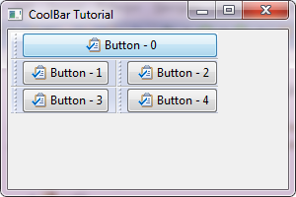
ToolBar and CoolBar
CoolBar and CoolItem
CoolBar
SWT.VERTICAL
SWT.HORIZONTAL
SWT.FLAT
setLock()
setWrapIndices()
CoolItem
Size
SWT.DROP_DOWN

Slide 28
ToolBar and CoolBar
CoolBar and CoolItem
final CoolBar coolBar = new CoolBar(shell, SWT.HORIZONTAL | SWT.FLAT);
for (int i = 0; i < 5; i++) {
CoolItem item = new CoolItem(coolBar, SWT.DROP_DOWN);
Button control = new Button(coolBar, SWT.NONE);
control.setImage(taskImage);
control.setText("Button - " + i);
item.setControl(control);
Point size = control.computeSize(SWT.DEFAULT, SWT.DEFAULT);
item.setPreferredSize(item.computeSize(size.x, size.y));
}
coolBar.setWrapIndices(new int[] { 1, 3 });
coolBar.pack();

Slide 29
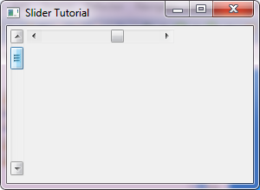
Slider, Scale and Spinner
Slider
SWT.VERTICAL
SWT.HORIZONTAL
Thumb
Slider vSlider = new Slider(shell, SWT.VERTICAL);
vSlider.setMaximum(100);
vSlider.setThumb(20);
Slider hSlider = new Slider(shell, SWT.HORIZONTAL);
hSlider.setMaximum(100);
hSlider.setSelection(50);
hSlider.setThumb(10);

Slide 30
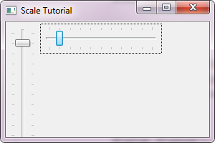
Slider, Scale and Spinner
Scale
SWT.VERTICAL
SWT.HORIZONTAL
Scale vScale = new Scale(shell, SWT.VERTICAL);
Scale hScale = new Scale(shell, SWT.HORIZONTAL);

Slide 31
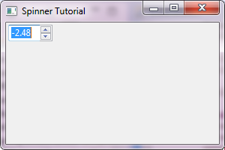
Slider, Scale and Spinner
Spinner
SWT.READ_ONLY
Digits
final Spinner spinner = new Spinner(shell, SWT.BORDER);
spinner.setMinimum(-10000);
spinner.setMaximum(10000);
spinner.setDigits(2);
spinner.setSelection(-248);

Slide 32
Slider, Scale and Spinner
Slider, Scale and Spinner
Maximum
Minimum
Selection
PageIncrement
Increment

Slide 33
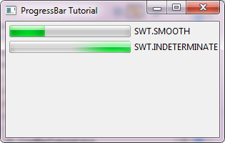
ProgressBar, Tray and ToolTip
ProgressBar
SWT.SMOOTH
SWT. INDETERMINATE
// SWT.DEFAULT | SWT.SMOOTH
final ProgressBar smoothBar = new ProgressBar(shell, SWT.SMOOTH);
smoothBar.setMaximum(100);
smoothBar.setSelection(30);
new Label(shell, SWT.NONE).setText("SWT.SMOOTH");
// SWT.INDETERMINATE
new ProgressBar(shell, SWT.INDETERMINATE);
new Label(shell, SWT.NONE).setText("SWT.INDETERMINATE");

Slide 34
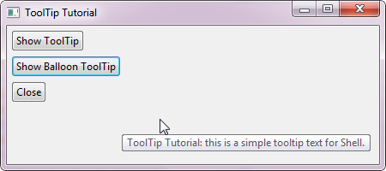
ProgressBar, Tray and ToolTip
ToolTip
Tooltip for control
shell.setToolTipText("ToolTip Tutorial: this is a simple tooltip text for Shell.");

Slide 35
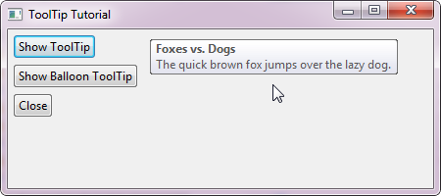
ProgressBar and ToolTip
ToolTip
Normal tooltip
final ToolTip tip = new ToolTip(shell, SWT.NONE);
tip.setText("Foxes vs. Dogs");
tip.setMessage("The quick brown fox jumps over the lazy dog.");
tip.setAutoHide(false);
final Button showTipButton = new Button(shell, SWT.NONE);
showTipButton.setText("Show ToolTip");
showTipButton.addListener(SWT.Selection, new Listener() {
public void handleEvent(Event event) {
if (tip.isVisible() || tip.isDisposed()) {
return;
}
Rectangle r = showTipButton.getBounds();
Point pt = showTipButton.toDisplay(r.x + r.width + 50, r.y);
tip.setLocation(pt);
tip.setVisible(true);
}
});

Slide 36
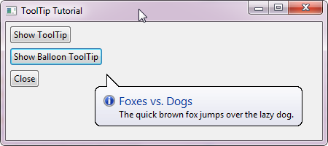
ProgressBar and ToolTip
ToolTip
Tooltip like balloon
final ToolTip balloon = new ToolTip(shell, SWT.BALLOON
| SWT.ICON_INFORMATION);
balloon.setText("Foxes vs. Dogs");
balloon.setMessage("The quick brown fox jumps over the lazy dog.");
balloon.setAutoHide(true);
final Button showTipButton2 = new Button(shell, SWT.NONE);
showTipButton2.setText("Show Balloon ToolTip");
showTipButton2.addListener(SWT.Selection, new Listener() {
public void handleEvent(Event event) {
if (balloon.isVisible() || balloon.isDisposed()) {
return;
}
Rectangle r = showTipButton2.getBounds();
Point pt = showTipButton2.toDisplay(r.x + r.width, r.y);
balloon.setLocation(pt);
balloon.setVisible(true);
}
});

Slide 37
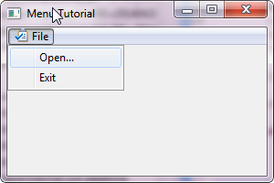
Menus
MenuBar
SWT.BAR
// MenuBar
Menu menuBar = new Menu(shell, SWT.BAR);
MenuItem fileItem = new MenuItem(menuBar, SWT.CASCADE);
fileItem.setText("File");
fileItem.setAccelerator('F');
fileItem.setImage(image);
// Drop_Down menu will be set as submenu for File menu.
Menu fileItemMenu = new Menu(fileItem);
new MenuItem(fileItemMenu, SWT.PUSH).setText("Open...");
new MenuItem(fileItemMenu, SWT.PUSH).setText("Exit");
fileItem.setMenu(fileItemMenu);
shell.setMenuBar(menuBar);

Slide 38
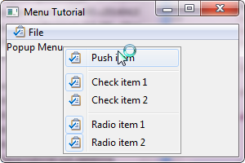
Menus
Context Menu
SWT.POP_UP
Menu contextMenu = new Menu(shell, SWT.POP_UP | SWT.NO_RADIO_GROUP);
MenuItem pushItem = new MenuItem(contextMenu, SWT.PUSH);
pushItem.setText("Push item");
pushItem.setImage(image);
new MenuItem(contextMenu, SWT.SEPARATOR);
…
label.setMenu(contextMenu);

Slide 39
Menus
Sub Menu
SWT.CASCADE
MenuItem fileItem = new MenuItem(menuBar, SWT.CASCADE);
fileItem.setText("File");
fileItem.setAccelerator('F');
fileItem.setImage(image);
// Drop_Down menu will be set as submenu for File menu.
Menu fileItemMenu = new Menu(fileItem);
new MenuItem(fileItemMenu, SWT.PUSH).setText("Open...");
new MenuItem(fileItemMenu, SWT.PUSH).setText("Exit");
fileItem.setMenu(fileItemMenu);

Slide 40
Tray and TaskBar
Tray and TrayItem
Tray tray = display.getSystemTray();
// Create tray item.
TrayItem item = new TrayItem(tray, SWT.NONE);
// Set images.
item.setImage(image);
item.setHighlightImage(image);
// Add tool tip.
final ToolTip toolTip = new ToolTip(shell, SWT.BALLOON);
toolTip.setText("Foxes vs. Dogs");
toolTip.setMessage("A quick brown fox jumps over the lazy dog.");
item.setToolTip(toolTip);

Slide 41
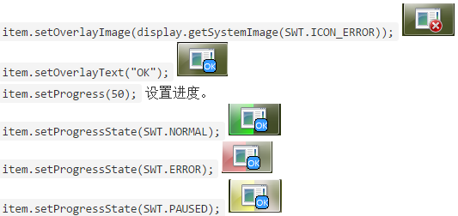
Tray and TaskBar
TaskBar and TaskItem
TaskBar taskBar = display.getSystemTaskBar();
TaskItem item = taskBar.getItem(shell);
if (item == null) {
item = taskBar.getItem(null);
}
item.setOverlayImage(display.getSystemImage(SWT.ICON_ERROR));
item.setOverlayText("OK");
item.setProgress(50);
item.setProgressState(SWT.PAUSED);

Slide 42
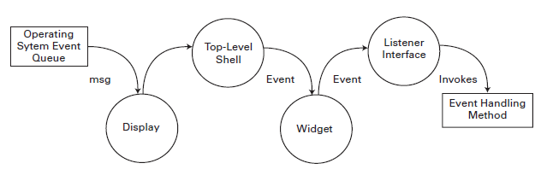
Working with events
Event processing with SWT

Slide 43
Working with events
Typed and untyped listeners
TypedEvent and TypedListener
Adapters
//typed
button.addSelectionListener(new SelectionListener() {
public void widgetSelected(SelectionEvent e) {
}
public void widgetDefaultSelected(SelectionEvent e) {
}
});
//Untyped
button.addListener(SWT.DefaultSelection, new Listener() {
public void handleEvent(Event event) {
}
});
button.addListener(SWT.Selection, new Listener() {
public void handleEvent(Event event) {
}
});

Slide 44
Working with events
Mouse and keyboard events
MouseEvent
enter
exit
hover
wheel scroll
double click
move
down
up
KeyEvent
character
stateMask
keyCode

Slide 45
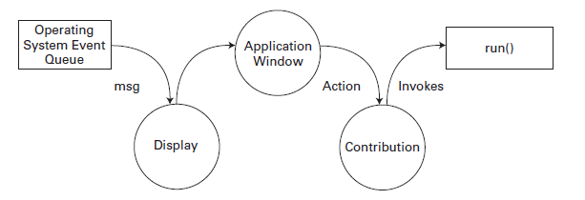
Working with events
Event processing with JFace

Slide 46
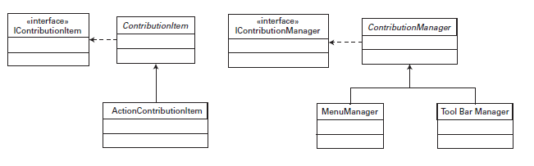
Working with events
Actions and contributions

Slide 47
Any Questions?
Skype: jin.liu.soyatec
Email: jin.liu@soyatec.com

Slide 48
The end

